Slide 1
Outline
Describing the fundamentals of distributed systems
Defining blockchain technology
Understanding how blockchain technology was developed
Detailing the elements of a blockchain
Identifying the benefits and limitations of blockchain technology

Slide 2
Introduction
Blockchain is a technology that has promised to positively alter the existing paradigms of nearly all industries including, but not limited to, the IT, finance, government, media, medical, and law sectors.
With the invention of Bitcoin in 2008, the world was introduced to a new concept, which revolutionized the whole of society. It was something that promised to have an impact upon every industry. This new concept was blockchain.
Many prominent organizations all around the world have moved on from the proof-of-concept stage and are already writing production systems utilizing blockchain. The disruptive potential of blockchain has now been fully recognized. For example, Decentralized Finance (DeFi) has recently emerged as a new disruptive idea that aims to decentralize the existing financial system. (Refer https://defipulse.com)

Slide 3
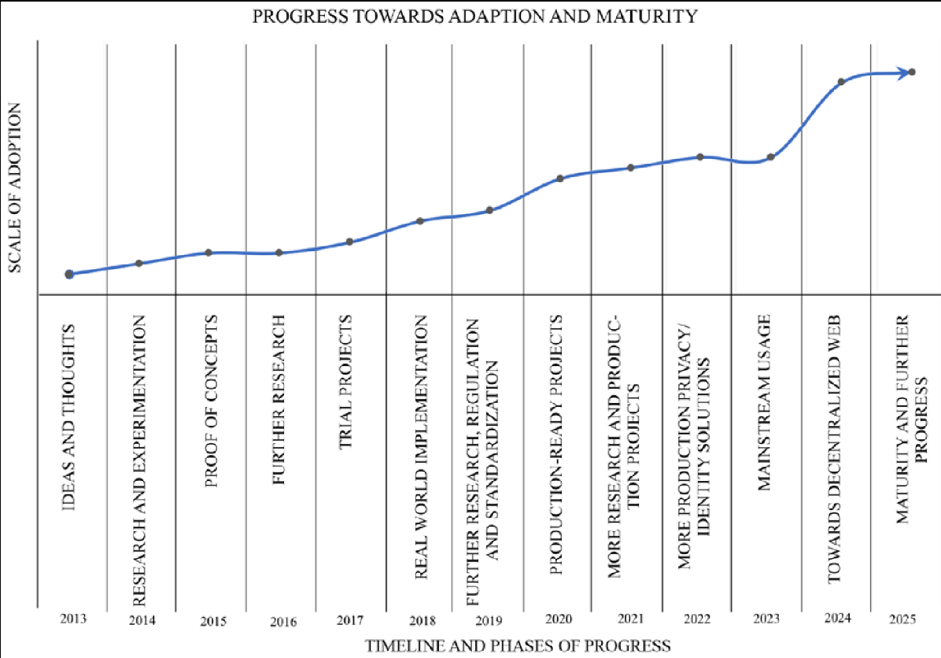

Slide 4
Distributed systems
Understanding distributed systems is essential to our understanding blockchain, as blockchain was a distributed system at its core.
It is a distributed ledger that can be centralized or decentralized.
A blockchain is originally intended to be and is usually used as a decentralized platform.
It can be thought of as a system that has properties of the both decentralized and distributed paradigms.
It is a decentralized-distributed system.

Slide 5
A distributed system is a computing paradigm whereby two or more nodes work with one another, in a coordinated fashion, to achieve a common outcome.
A distributed system is modeled in such a way that end users see it as a single logical platform.
For example, Google's search engine is based on a large distributed system; however, to a user, it looks like a single, coherent platform
A node can be defined as an individual player in a distributed system. All nodes are capable of sending and receiving messages to and from each other.
Nodes can be honest, faulty, or malicious, and they have memory and a processor.
A node that exhibits irrational behavior is also known as a Byzantine node after the Byzantine Generals problem.

Slide 6


The Byzantine Generals problem
Attack?
5
?
Attack
Retreat
?
Retreat
?
Attack
?
Attack or retreat?
Consensus required to win
https://www.microsoft.com/en-us/research/publication/byzantine-generals-problem/

Slide 7
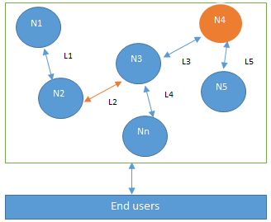
Design of a distributed system
N4 is a Byzantine node, L2 is broken or a slow network link

Slide 8
This type of inconsistent behavior of Byzantine nodes can be intentionally malicious, which is detrimental to the operation of the network.
Any unexpected behavior by a node on the network, whether malicious or not, can be categorized as Byzantine.
The primary challenge of a distributed system design is the coordination between nodes and fault tolerance.
Even if some (a certain threshold dictated by the consensus protocol) of the nodes become faulty or network links break, the distributed system should be able to tolerate this and continue to work to achieve the desired result.
This problem has been an active area of distributed system design research for many years, and several algorithms and mechanisms have been proposed to overcome these issues.

Slide 9
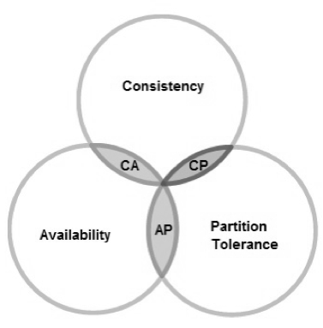
CAP theorem
Distributed systems are so challenging to design that a theory known as the CAP theorem has been proven, which states that a distributed system cannot have all three of the desired properties simultaneously; that is:
Consistency
Availability
Partition tolerance

Slide 10
Consistency is a property that ensures that all nodes in a distributed system have a single, current, and identical copy of the data.
Availability means that the nodes in the system are up, accessible for use, and are accepting incoming requests and responding with data without any failures as and when required. In other words, data is available at each node and the nodes are responding to requests.
Partition tolerance ensures that if a group of nodes is unable to communicate with other nodes due to network failures, the distributed system continues to operate correctly. This can occur due to network and node failures.

Slide 11
The preceding diagram shows that only two properties at a time can be achieved. Either AP, CA, or CP.
In summary:
If we opt for CP (consistency and partition tolerance), we sacrifice availability.
If we opt for AP (availability and partition tolerance), we sacrifice consistency.
If we opt for AC (availability and consistency), we sacrifice partition tolerance.
Usually, a network partition cannot be ignored; therefore, the choice mostly becomes either consistency or availability in the case of a network partition.

Slide 12
Blockchain was introduced with the invention of Bitcoin in 2008. Its practical implementation then occurred in 2009
The events that led to blockchain
1960s – Invention of computer networks
1969 – Development of ARPANET
1970s – Early work on secure network communication including public key cryptography
1970s – Cryptographic hash functions
1973 – Extension of ARPANET to other geographic locations
1974 – First internet service provider, Telenet
1976 – Diffie–Hellman work on securely exchanging cryptographic keys

Slide 13
1978 – Invention of public key cryptography
1979 – Invention of Merkle Trees (hashes in a tree structure) by Ralph C. Merkle
1980s – Development of TCP/IP
1980 – Protocols for public key cryptosystems, Ralph C. Merkle
1982 – Blind signatures proposed by David Chaum
1982 – The Byzantine Generals Problem (Bitcoin can be considered a solution to the Byzantine Generals Problem; however, the original intention of the Bitcoin network was to address the previously unsolved double-spending problem)
1985 – Work on elliptic curve cryptography by Neal Koblitz and Victor Miller
1991 – Haber and Stornetta work on tamper proofing document timestamps. This can be considered the earliest idea of a chain of blocks or hash chains

Slide 14
1992 – Cynthia Dwork and Moni Naor publish Pricing via Processing or Combatting Junk Mail. This is considered the first use of Proof of Work (PoW)
1993 – Haber, Bayer, and Stornetta upgraded the tamper-proofing of document timestamps system with Merkle trees
1995 – David Chaum's Digicash system (an anonymous electronic cash system) started to be used in some banks
1998 – Bit Gold, a mechanism for decentralized digital currency, invented by Nick Szabo. It used hash chaining and Byzantine Quorums
1999 – Emergence of a file-sharing application mainly used for music sharing, Napster, which is a P2P network, but was centralized with the use of indexing servers
1999 – Development of a secure timestamping service for the Belgian project TIMESEC

Slide 15
2000 – Gnutella file-sharing network, which introduced decentralization
2001 – Emergence of BitTorrent and Distributed Hash Tables (DHTs)
2002 – Hashcash by Adam Back
2004 – Development of B-Money by Wei Dei using hashcash
2004 – Hal Finney, the invention of the reusable PoW system
2005 – Prevention of Sybil attacks by using computation puzzles, due to James Aspnes et al.
2009 – Bitcoin (first blockchain)

Slide 16
Electronic cash
The concept of electronic cash (e-cash), or digital currency, is not new. Since the 1980s, e-cash protocols have existed.
Two fundamental e-cash system issues need to be addressed: accountability and anonymity.
Accountability is required to ensure that cash is spendable only once (addressing the double spending problem) and that it can only be spent by its rightful owner. The double-spending problem arises when the same money can be spent twice. As it is quite easy to make copies of digital data, this becomes a big issue in digital currencies as you can make many copies of the same amount of digital cash.
Anonymity is required to protect users' privacy. With physical cash, it is almost impossible to trace back spending to the individual who actually paid the money, which provides adequate privacy should the consumer choose to hide their identity. In the digital world, however, providing such a level of privacy is difficult due to inherent personalization, tracing, and logging mechanisms in digital payment systems such as credit card payments. This is indeed a required feature for ensuring the security and safety of the financial network, but it is also often seen as a breach of privacy.

Slide 17
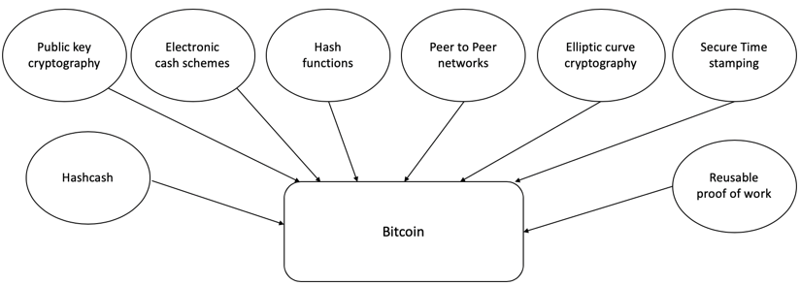
How did blockchain technology develop?
1950s – Hash functions
1970s – Merkle trees - hashes in a tree structure
1970s continued – Research in distributed systems, consensus, state machine replication
1980s – Hash chains for secure logins
1990s – e-Cash for e-payments
1991 – Secure timestamping of digital documents.
1992 – Hashcash idea to combat junk emails
1994 – S/KEY application for Unix login.
1997/2002 – Hashcash
2008/2009 – Bitcoin (the first blockchain)

Slide 18
Blockchain
In 2008, a groundbreaking paper, entitled Bitcoin: A Peer-to-Peer Electronic Cash System, was written on the topic of peer-to-peer e-cash under the pseudonym of Satoshi Nakamoto.
This paper is available at https://bitcoin.org/bitcoin.pdf.
It introduced the term chain of blocks. No one knows the actual identity of Satoshi Nakamoto. After introducing Bitcoin in 2009, he remained active in the Bitcoin developer community until 2011. He then handed over Bitcoin development to its core developers and simply disappeared. Since then, there has been no communication from him whatsoever, and his existence and identity are shrouded in mystery. The term "chain of blocks" evolved over the years into the word "blockchain."

Slide 19
Defining ‘Blockchain’
Layman's definition: Blockchain is an ever-growing, secure, shared recordkeeping system in which each user of the data holds a copy of the records, which can only be updated if all parties involved in a transaction agree to update.
Technical definition: Blockchain is a peer-to-peer distributed ledger that is cryptographically-secure, append-only, immutable (extremely hard to change), and updateable only via consensus or agreement among peers.

Slide 20
Peer-to-peer
The first keyword in the technical definition is peer-to-peer, or P2P This means that there is no central controller in the network, and all participants (nodes) talk to each other directly. This property allows for transactions to be conducted directly among the peers without third-party involvement, such as by a bank.
Distributed ledger
blockchain is a "distributed ledger," which means that a ledger is spread across the network among all peers in the network, and each peer holds a copy of the complete ledger.

Slide 21
Cryptographically secure
ledger is "cryptographically secure," which means that cryptography has been used to provide security services that make this ledger secure against tampering and misuse. These services include non-repudiation, data integrity, and data origin authentication.
Append only
blockchain is "append-only," which means that data can only be added to the blockchain in time-sequential order. This property implies that once data is added to the blockchain, it is almost impossible to change that data and it can be considered practically immutable. In other words, blocks added to the blockchain cannot be changed, which allows blockchain to become an immutable and tamper-proof ledger of transactions.

Slide 22
Updatable via consensus
The most critical attribute of a blockchain is that it is updateable only via consensus. This is what gives it the power of decentralization.
In this scenario, no central authority is in control of updating the ledger. Instead, any update made to the blockchain is validated against strict criteria defined by the blockchain protocol and added to the blockchain only after a consensus has been reached among all participating peers/nodes on the network.
To achieve consensus, there are various consensus algorithms that ensure all parties agree on the final state of the data on the blockchain network.

Slide 23
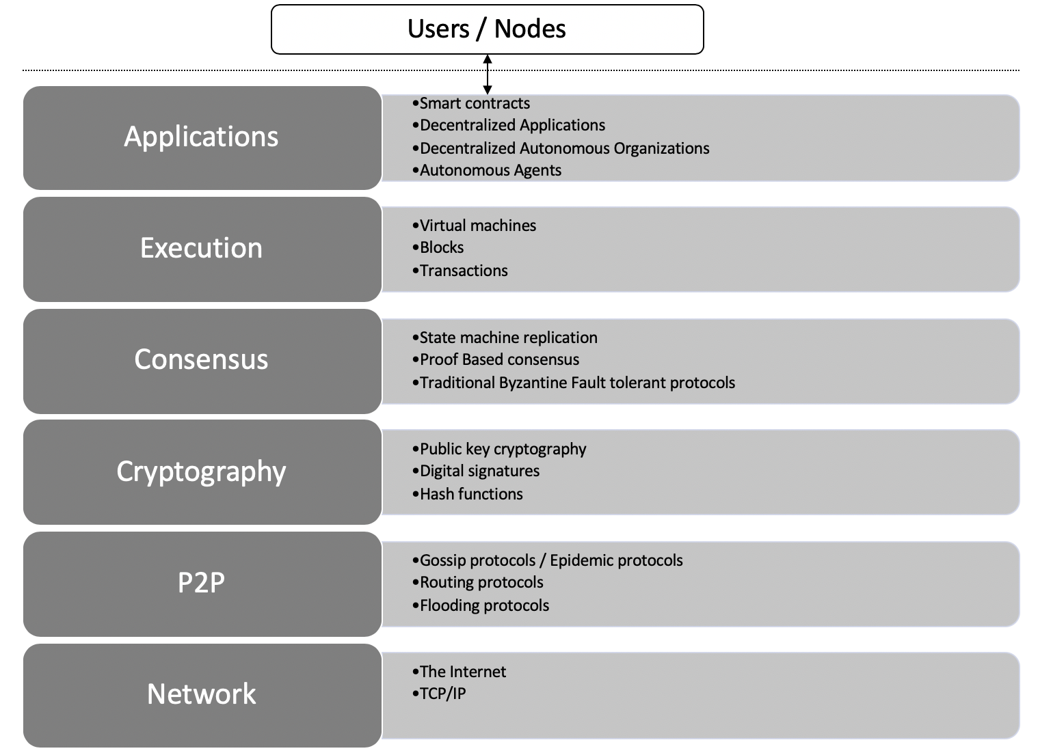
Architectural view of Blockchain

Slide 24
the lowest layer is the Network, which is usually the internet and provides a base communication layer for any blockchain.
A peer-to-peer network runs on top of the Network layer, which consists of information propagation protocols such as gossip or flooding protocols.
Cryptography layer, which contains crucial cryptographic protocols that ensure the security of the blockchain.
Consensus layer, which is concerned with the usage of various consensus mechanisms to ensure agreement among different participants of the blockchain.
Notes:
A gossip protocol is a communication method used in distributed systems to disseminate information among nodes in a network. It works by having each node periodically share information with a few randomly selected other nodes, similar to how rumors spread in a social network. This process continues until all nodes in the network have received the information.

Slide 25
Execution layer, which can consist of virtual machines, blocks, transaction, and smart contracts. This layer, as the name suggests, provides executions services on the blockchain and performs operations such as value transfer, smart contract execution, and block generation. Virtual machines such as Ethereum Virtual Machine (EVM) provide an execution environment for smart contracts to execute.
Finally, the Applications layer, which is composed of smart contracts, decentralized applications, DAOs, and autonomous agents. This layer can effectively contain all sorts of various user level agents and programs that operate on the blockchain. Users interact with the blockchain via decentralized applications.

Slide 26
Generic structure of a blockchain
Genesis block
Transactions & other data
Previous hash
Block 1
Transactions & other data
Previous hash
Block 2
Transactions & other data
Previous hash
Block N
Transactions & other data
. . . . .

Slide 27
Generic elements of a blockchain
Addresses
Addresses are unique identifiers used in a blockchain transaction to denote senders and recipients. An address is usually a public key or derived from a public key algorithm.
Transactions
A transaction is the fundamental unit of a blockchain. A transaction represents a transfer of value from one address to another.
Blocks
A block is composed of multiple transactions and other elements, such as the previous block hash (hash pointer), timestamp, and nonce.
Peer-to-peer network
As the name implies, a peer-to-peer network is a network topology wherein all peers can communicate with each other and send and receive messages.

Slide 28
Generic elements of a blockchain
Scripting or programming language
Scripts or programs perform various operations on a transaction in order to facilitate various functions.
Virtual machine
A virtual machine allows Turing complete code to be run on a blockchain (as smart contracts).
However, virtual machines are not available on all blockchains. Various blockchains use virtual machines to run programs such as Ethereum Virtual Machine (EVM) and Chain Virtual Machine (CVM). EVM is used in the Ethereum blockchain, while CVM is a virtual machine developed for and used in an enterprise-grade blockchain called "Chain Core."

Slide 29
State machine
A blockchain can be viewed as a state transition mechanism whereby a state is modified from its initial form to the next one by nodes on the blockchain network as a result of transaction execution.
Nodes
A node in a blockchain network performs various functions depending on the role that it takes on.
Smart contracts
These programs run on top of the blockchain and encapsulate the business logic to be executed when certain conditions are met. The smart contract feature is not available on all blockchain platforms, but it is now becoming a very desirable feature due to the flexibility and power that it provides to blockchain applications. Smart contracts have many use cases, including but not limited to identity management, capital markets, trade finance, record management, insurance, and e-governance.
Notes:
A smart contract in blockchain is a self-executing, digital agreement written in code and stored on a blockchain network. It automatically executes the terms of a contract when predefined conditions are met, eliminating the need for intermediaries and ensuring transparency and immutability. Think of it like a vending machine: you put in the money, press the button, and the machine dispenses the product, all automatically based on the pre-set rules.

Slide 30
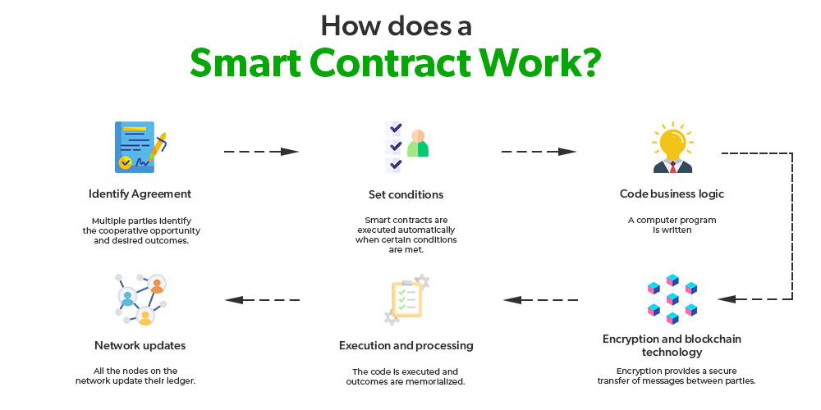

Slide 31
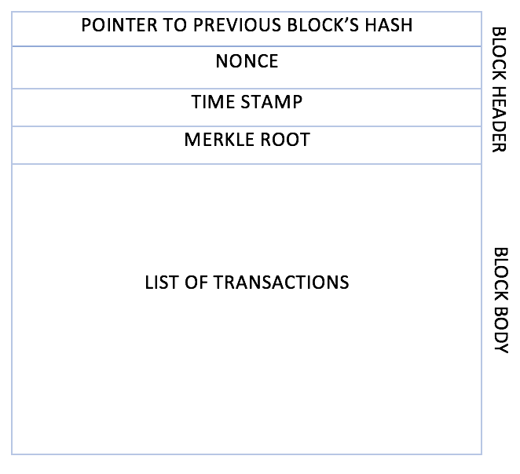
Generic block structure
A block is composed of multiple transactions and other elements, such as the previous block hash (hash pointer), timestamp, and nonce. A block is composed of a block header and a list of transactions bundled together and organized logically.

Slide 32
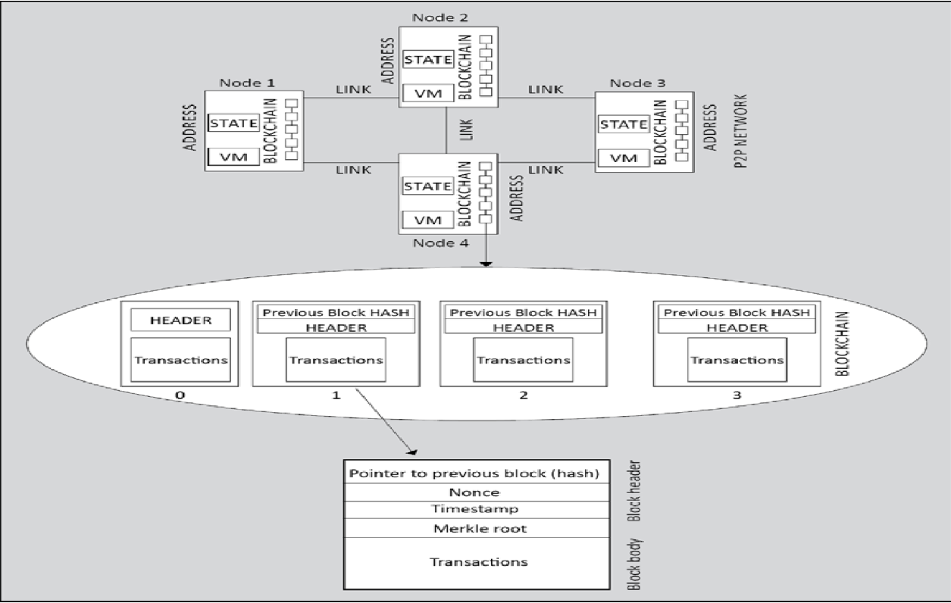

Slide 33
How blockchain works?
Nodes are either
miners who create new blocks and mine cryptocurrency (coins) or
block signers who validate and digitally sign the transactions.
A critical decision that every blockchain network has to make is to figure out which node will append the next block to the blockchain. This decision is made using a consensus mechanism

Slide 34
Transaction is initiated
Transaction is validated and broadcast
Find new block
New block found
Add new block to the blockchain

Slide 35








How a blockchain works
1. User X transacts with User Y
2. Transaction broadcast
3. Find new block (mining)
4. New block found (mined)
Smart contract or transfer of value
5. Add new block to the blockchain

Slide 36
Benefits of blockchain
Decentralization
This is a core concept and benefit of blockchain. There is no need for a trusted third party or intermediary to validate transactions; instead, a consensus mechanism is used to agree on the validity of transactions
Transparency and Trust
As blockchains are shared and everyone can see what is on the blockchain, this allows the system to be transparent. As a result, trust is established. This is more relevant in scenarios such as the disbursement of funds or benefits where personal discretion in relation to selecting beneficiaries needs to be restricted.
Immutability
Once the data has been written to the blockchain, it is extremely difficult to change it back. It is not genuinely immutable, but because changing data is so challenging and nearly impossible, this is seen as a benefit to maintaining an immutable ledger of transactions.

Slide 37
Benefits of blockchain
High availability
As the system is based on thousands of nodes in a peer-to-peer network, and the data is replicated and updated on every node, the system becomes highly available. Even if some nodes leave the network or become inaccessible, the network as a whole continues to work, thus making it highly available. This redundancy results in high availability.
Highly secure
All transactions on a blockchain are cryptographically secured and thus provide network integrity. Any transactions posted from the nodes on the blockchain are verified based on a predetermined set of rules. Only valid transactions are selected for inclusion in a block. The blockchain is based on proven cryptographic technology that ensures the integrity and availability of data. Generally, confidentiality is not provided due to the requirements of transparency. This limitation is the leading barrier to its adoption by financial institutions and other industries that require the privacy and confidentiality of transactions.

Slide 38
Benefits of blockchain
Faster transactions
In the financial industry, especially in post-trade settlement functions, blockchain can play a vital role by enabling the quick settlement of trades. Blockchain does not require a lengthy process of verification, reconciliation, and clearance because a single version of agreed-upon data is already available on a shared ledger between financial organizations.
Cost saving
As no trusted third party or clearing house is required in the blockchain model, this can massively eliminate overhead costs in the form of the fees, which are paid to such parties.

Slide 39
Benefits of blockchain
Platform for smart contracts
A blockchain is a platform on which programs can run that execute business logic on behalf of the users. This is a very useful feature but not all blockchains have a mechanism to execute smart contracts; however, this is a very desirable feature. It is available on newer blockchain platforms such as Ethereum and MultiChain, but not on Bitcoin.

Slide 40
Limitations of blockchain
Scalability
Currently, blockchain networks are not as scalable as, for example, current financial networks. This is a known area of concern and a very ripe area for research.
Adaptability
Often, blockchain is seen as a nascent technology. Even though this perspective is rapidly changing, there is still a long way to go before the mass adoption of this technology. The challenge here is to allow blockchain networks to be easier to use so that adoption can increase. In addition, several other challenges such as scalability exist, which must be solved in order to increase adoption.
Relatively immature technology
As compared to traditional IT systems that have benefited from decades of research, blockchain is still a new technology and requires a lot of research to achieve maturity.

Slide 41
Limitations of blockchain
Regulation
Due to its decentralized nature, regulation is almost impossible on blockchain. This is sometimes seen as a barrier toward adoption because, traditionally, due to the existence of regulatory authorities, consumers have a certain level of confidence that if something goes wrong they can hold someone accountable. However, in blockchain networks, no such regulatory authority and control exists, which is an inhibiting factor for many consumers.
Privacy and confidentiality
Privacy is a concern on public blockchains such as Bitcoin where everyone can see every single transaction. This transparency is not desirable in many industries such as the financial, law, or medical sectors. This is also a known concern and a lot of valuable research with some impeccable solutions has already been developed. However, further research is still required to drive the mass adoption of blockchain.

Slide 42
Types of blockchain
Distributed ledgers
a distributed ledger is a broad term describing shared databases;
hence, all blockchains technically fall under the umbrella of shared databases or distributed ledgers.
Although all blockchains are fundamentally distributed ledgers, all distributed ledgers are not necessarily blockchains.
A critical difference between a distributed ledger and a blockchain is that a distributed ledger does not necessarily consist of blocks of transactions to keep the ledger growing. Rather, a blockchain is a special type of shared database that is comprised of blocks of transactions.
R3's Corda (https://www.corda.net) is a distributed ledger developed to record and manage agreements and is especially focused on the financial services industry. On the other hand, more widely known blockchains like Bitcoin and Ethereum make use of blocks to update the shared database.

Slide 43
a distributed ledger is distributed among its participants and spread across multiple sites or organizations.
This type of ledger can be either private or public.
The fundamental idea here is that, unlike many other blockchains, the records are stored contiguously instead of being sorted into blocks.
This concept is used in Ripple, which is a blockchain- and cryptocurrency-based global payment network.

Slide 44
Distributed Ledger Technology
Distributed ledger or DLT commonly used to describe blockchain in the finance industry.
Sometimes, blockchain and DLT are used interchangeably.
In fact, DLT is now a very active and thriving area of research in the financial sector.
From a financial sector point of view, DLTs are permissioned blockchains that are used by consortiums.
DLTs usually serve as a shared database, with all participants known and verified.
They do not have a cryptocurrency and do not require mining to secure the ledger.
At a broader level, DLT is an umbrella term that represents Distributed Ledger Technology as a whole, comprising of blockchains and distributed ledgers of different types

Slide 45
Public blockchains
As the name suggests, public blockchains are not owned by anyone.
They are open to the public, and anyone can participate as a node in the decision-making process.
Users may or may not be rewarded for their participation.
All users of these "permissionless" or "un-permissioned“ ledgers maintain a copy of the ledger on their local nodes and use a distributed consensus mechanism to decide the eventual state of the ledger.
Bitcoin and Ethereum are both considered public blockchains.

Slide 46
Private blockchains
As the name implies, private blockchains are just that—private.
That is, they are open only to a consortium or group of individuals or organizations who have decided to share the ledger among themselves.
There are various blockchains now available in this category, such as Kadena and Quorum.
Optionally, both of these blockchains can also run in public mode if required, but their primary purpose is to provide a private blockchain.

Slide 47
Semi-private blockchains
With semi-private blockchains, part of the blockchain is private and part of it is public.
this is still just a concept today, and no real-world proofs of concept have yet been developed.
With a semi-private blockchain, the private part is controlled by a group of individuals, while the public part is open for participation by anyone.
This hybrid model can be used in scenarios where the private part of the blockchain remains internal and shared among known participants, while the public part of the blockchain can still be used by anyone, optionally allowing mining to secure the blockchain.
This type of blockchain can also be called a "semidecentralized“ model, where it is controlled by a single entity but still allows for multiple users to join the network by following appropriate procedures.

Slide 48
Permissioned ledger
A permissioned ledger is a blockchain where participants of the network are already known and trusted.
Permissioned ledgers do not need to use a distributed consensus mechanism; instead, an agreement protocol is used to maintain a shared version of the truth about the state of the records on the blockchain.
In this case, for verification of transactions on the chain, all verifiers are already preselected by a central authority and, typically, there is no need for a mining mechanism.
By definition, there is also no requirement for a permissioned blockchain to be private, as it can be a public blockchain but with regulated access control.
For example, Bitcoin can become a permissioned ledger if an access control layer is introduced on top of it that verifies the identity of a user and then allows access to the blockchain.

Slide 49
Shared ledger
This is a generic term that is used to describe any application or database that is shared by the public or a consortium. Generally, all blockchains fall into the category of a shared ledger.
Fully private and proprietary blockchains
There is no mainstream application of these types of blockchains, as they deviate from the core concept of decentralization in blockchain technology. Nonetheless, in specific private settings within an organization, there could be a need to share data and provide some level of guarantee of the authenticity of the data. An example of this type of blockchain might be to allow for collaboration and the sharing of data between various government departments.

Slide 50
Tokenized blockchains
These blockchains are standard blockchains that generate cryptocurrency as a result of a consensus process via mining or initial distribution. Bitcoin and Ethereum are prime examples of this type of blockchain.
Tokenless blockchains
These blockchains are designed in such a way that they do not have the basic unit for the transfer of value. However, they are still valuable in situations where there is no need to transfer value between nodes and only the sharing of data among various trusted parties is required. This is similar to fully private blockchains, the only difference being that the use of tokens is not required. This can also be thought of as a shared distributed ledger used for storing and sharing data between the participants.

